Slide 1

Clustering of Taipei neighborhoods for new visitors
By Yan jia

Slide 2
Background/Business problem
Taipei, the political, economic, educational and cultural center of Taiwan, attracts millions of visitors each year, making it the 15th most visited city globally, and the most of any city in the Chinese-speaking world
Large amount of available travel information and recommendations are overwhelming, but it is not easy for new visitors make quick decisions on where to stay for their first visits.
Taipei’s different neighborhoods might better cater for different visitors based on their personal preferences and purpose for their visits
A clustering of Taipei’s neighborhoods can provide new visitors with valuable and quick insights to facilitate their decision-making

Slide 3

Data sources
List of the administrative districts of Taipei City with postal codes – scraped from Wikipedia.
Location coordinates data of Taipei city and its administrative districts acquired by using geocoding tool geopy
Nearly 900 top venues found by Foursquare API for query of top 200 venues of each Taipei district within a radius of 1000m

Slide 4
Data processing
Applied one-hot encoding technique to indicate the existence/non-existence of each venue category for each neighborhood
Calculated the mean occurence of each venue category for each neighborhood
Calculated the top 10 most popular venue categories for each neighborhood

Slide 5

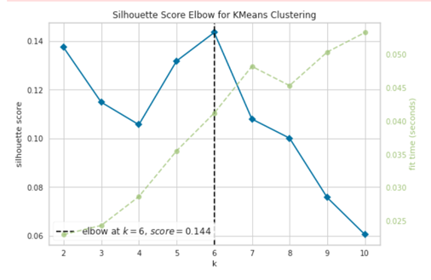
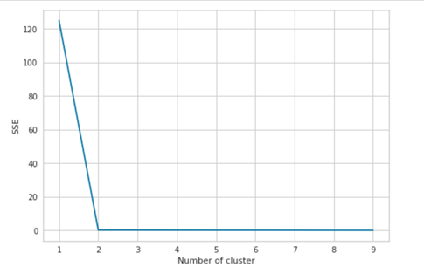
K-means clustering
Used unsupervised learning algorithm K-means to cluster the neighborhoods
Used two different metrics of the Elbow method, silhouette and inertia to find the best K value for clustering
Test results suggested two possible best K values, 2 and 6

Slide 6

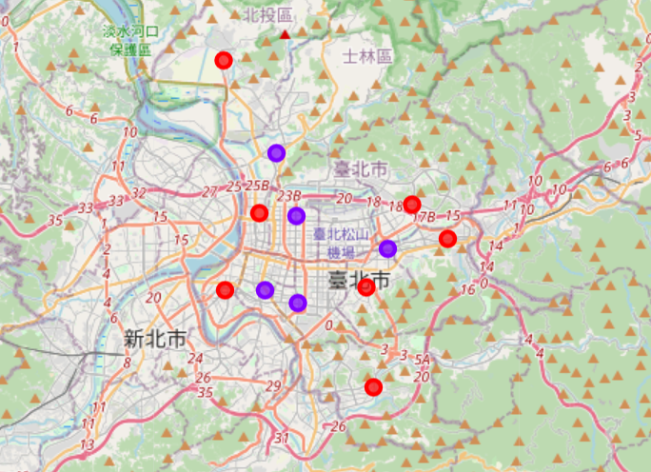
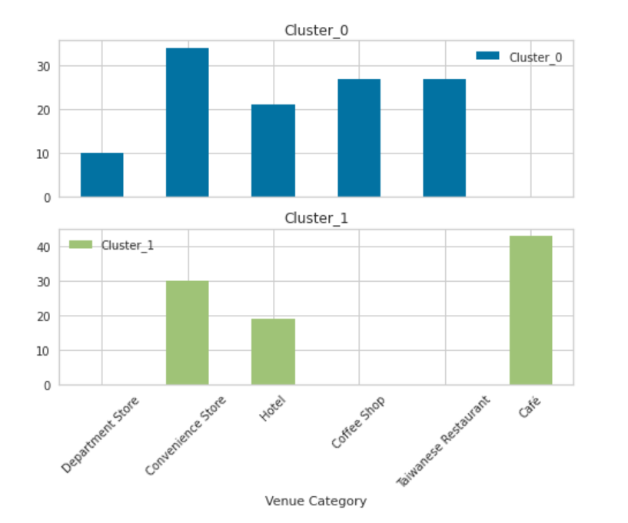
Clustering results (1/2)
Splitting data into 2 clusters
Cluster 0: Outer Ring Multifunctional Life Social Circles (red dots in map on the right)
Cluster 1: Inner Ring Café & Accommodation Areas (purple dots in map on the right)

Slide 7
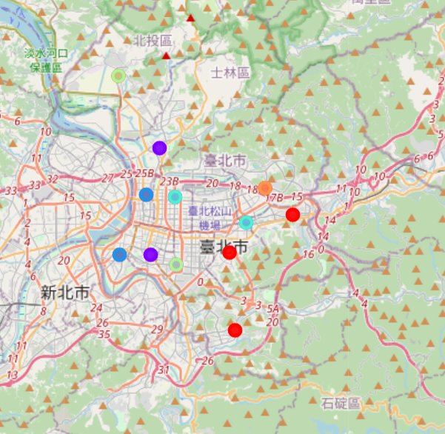
Clustering results (2/2)
Splitting data into 6 clusters
Details of top venue categories revealed some common characteristics of the neighborhoods that are clustered into same clusters, however, differences among the clusters do not seem to be big enough
Does not seem to be a good clustering

Slide 8

Discussion & future improvements
Only 12 coordinates were used for query Foursquare data, which could have put some limitations on the dataset. More coordinates can be used for future explorations.
The elbow method gave me different best K values, based on different metrics used. The test result using silhouette is also quite low, which indicates non-existence of clear clusters in the dataset. Future studies can use different clustering algorithms to improve the clustering.
Two attempts of clustering with potential best K values of 2 and 6 were made. By analyzing the clustering results, I came to the conclusion that splitting the neighborhoods into 2 clusters is a better clustering.
This study lies on the dependency on Foursquare data, which is updated on daily basis, and this has caused the clustering results were changing from time to time, especially when the top venue categories of each neighborhood turned out to essentially quite similar.
Different and more data from Foursquare can be used to improve the dataset so that the dissimilarities among the neighborhoods are better identified. Foursquare’s explore endpoint was used to get the current data, which is dominated by “food” venues at subcategory level. Potential improvements can be done by acquiring number of Foursquare’s 10 main venue categories in each neighborhood or using trending endpoint to get the most popular venues at certain time periods.

Slide 9

Conclusions
Activity density differs among Taipei’s 12 neighborhoods, as the number of top venues within the defined same radius for each neighborhood show clear differences, while the lifestyles and local environment do not show significant differences among the neighborhoods.
The neighborhoods can be roughly split into 2 clusters, namely the “Outer Ring Multifunctional Life Social Circles” where large number of various life, accommodation, and social venues are available, as well as the “Inner Ring Café & Accommodation Areas” where convenience stores, hotels and cafés are most popular.
For visitors new to Taipei city, wherever they choose to stay in the city, they will be able to have an all-around experience of Taipei in a slightly different way.

